Slide 1
Node voltage analysis
Module 1: Fundamentals of DC Circuits
EEE1024 Fundamentals of Electrical and Electronics Engineering

Slide 2
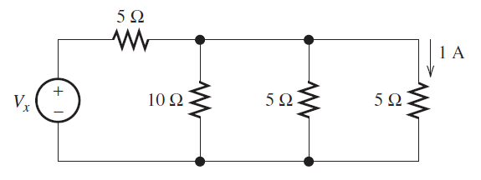
Ohm’s law, kcl & kvl
1. Consider the circuit shown in Figure, Use repeated applications of Ohm’s law, KVL, and KCL to eventually find Vx.

Slide 3
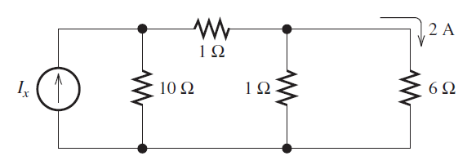
Ohm’s law, kcl & kvl
2. Use repeated applications of Ohm’s law, KVL, and KCL to eventually find the value of Ix in the circuit
Assignment 1

Slide 4



Resistance's in series and Parallel

Slide 5
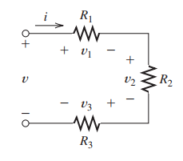
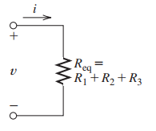

Series Resistances
Consider the series combination of three resistances shown in Figure.
Recall that in a series circuit the elements are connected end to end and that the same current flows through all the elements.
Using KVL
$$v=v_{1}+v_{2}+v_{3}$$
Using Ohm’s Law
$$v={iR}_{1}+iR_{2}+iR_{3}$$
$$v={i(R}_{1}+R_{2}+R_{3})$$
$$v=i\left(R_{eq}\right)$$
$$R_{eq}=R_{1}+R_{2}+R_{3}$$

Slide 6
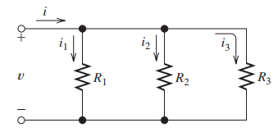
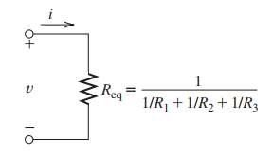
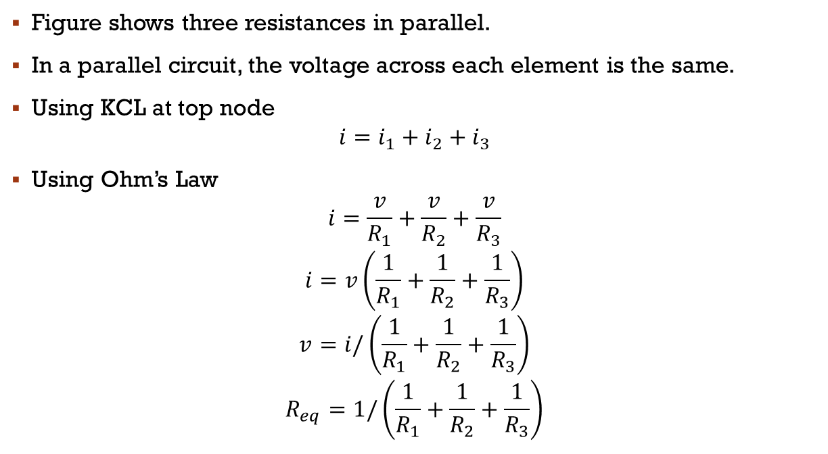
Parallel elements
Figure shows three resistances in parallel.
In a parallel circuit, the voltage across each element is the same.
Using KCL at top node
$$i=i_{1}+i_{2}+i_{3}$$
Using Ohm’s Law
$$i=\frac{v}{R_{1}}+\frac{v}{R_{2}}+\frac{v}{R_{3}}$$
$$i=v\left(\frac{1}{R_{1}}+\frac{1}{R_{2}}+\frac{1}{R_{3}}\right)$$
$$v=i/\left(\frac{1}{R_{1}}+\frac{1}{R_{2}}+\frac{1}{R_{3}}\right)$$
$$R_{eq}=1/\left(\frac{1}{R_{1}}+\frac{1}{R_{2}}+\frac{1}{R_{3}}\right)$$

Slide 7
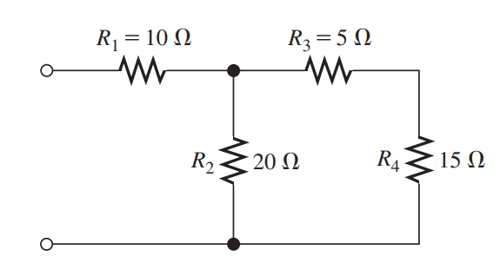
Combining Resistances in Series and Parallel
Find a single equivalent resistance for the network shown in Figure

Slide 8


node-voltage analysis

Slide 9
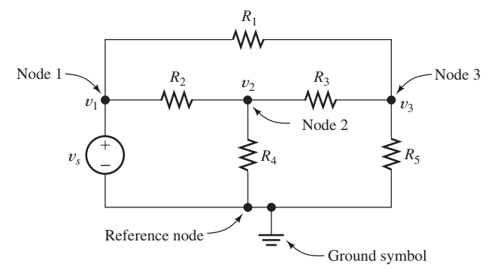
Can we apply KCL, KVl and Other ???

Slide 10
node-voltage analysis
Node-voltage analysis, which is a general technique that can be applied to any circuit
In node-voltage analysis, we write equations and eventually solve for the node voltages.
Once the node voltages have been found, it is relatively easy to find the current, voltage, and power for each element in the circuit.

Slide 11
Example 1
Node 1
Node 2
Node 3

Slide 12
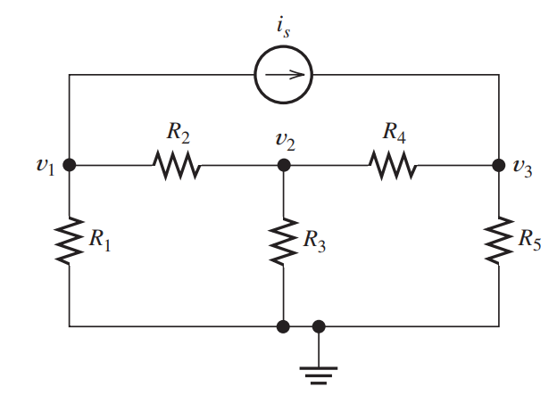
Example 2
Node 1
Node 2
Node 3

Slide 13
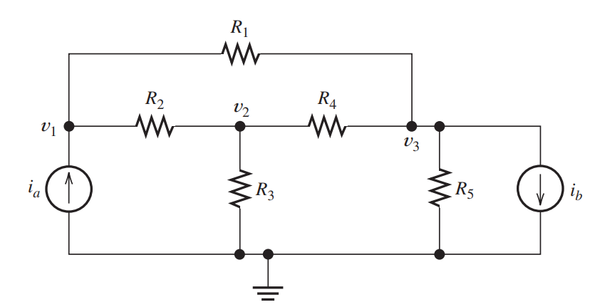
Example 3
Node 1
Node 2
Node 3
Node 4

Slide 14
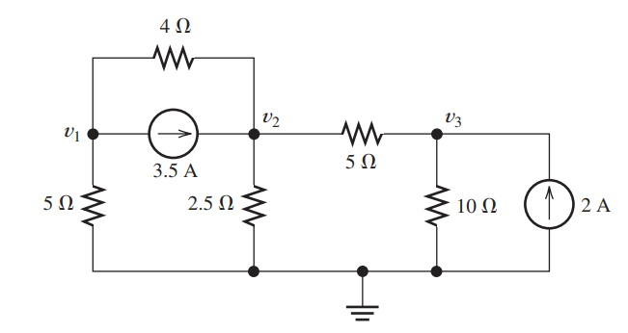
Example 4
Find Node Voltages

Slide 15
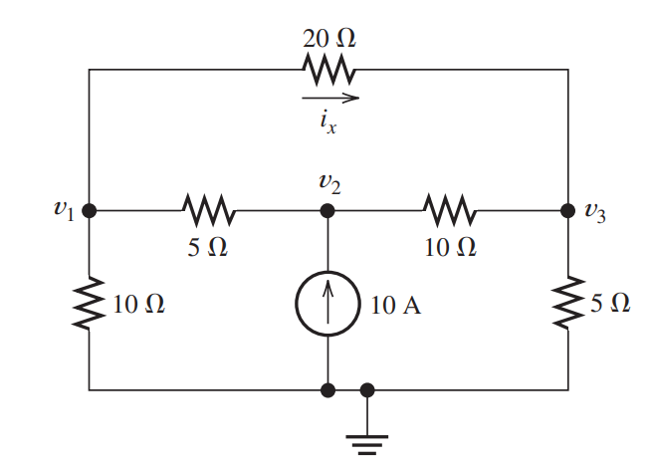
Example 5
Find Node Voltages & ix

Slide 16
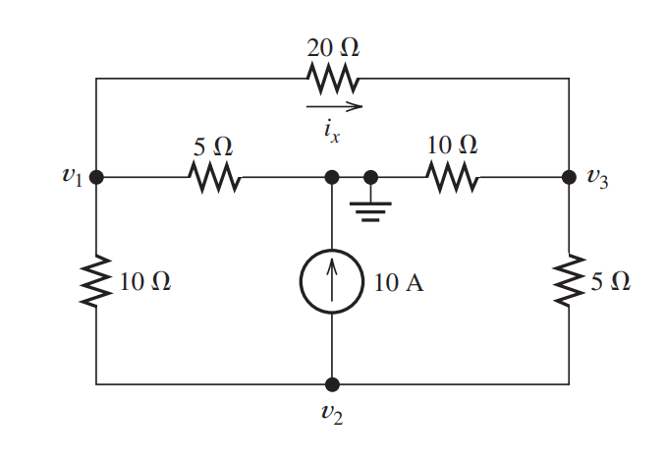
Assignment 2
Find Node Voltages and ix

